Slide 1
Review of HPC Resource Management
Slurm & Torque
Elham Adibi
DSN Lab, CE Dept., Sharif Univ of Tech.
http://dsn.ce.sharif.edu
May 2022

Slide 2
Batch-Resource Management
Compute nodes
Job
script
User
Job queue
Login / front-end nodes
RM/scheduler
Resource Management (RM) is software that implements a batch system on a HPC (is responsible for delivering computing power to applications)
RM evaluates job script resource requirements, priorities and distributes the jobs to suitable compute nodes
On an HPC system, the scheduler manages which jobs run where and when

Slide 3
Life Cycle of a Job
States of a job:
  Creation: Jobs are created by user
  Submission: user submits the job specified in file job_script to the batch system
  Execution: when the resources requested by a job are available
  Completion: when the tasks of a job are terminated
Creation:
A job script contains the information of a job
Submission:
Torque: qsub script.sh, Slurm: sbatch script.sh
Execution:
Resource is reserved and code is launched
Completion:
Execution completed and stdout and stderr are write to submission directory

Slide 4
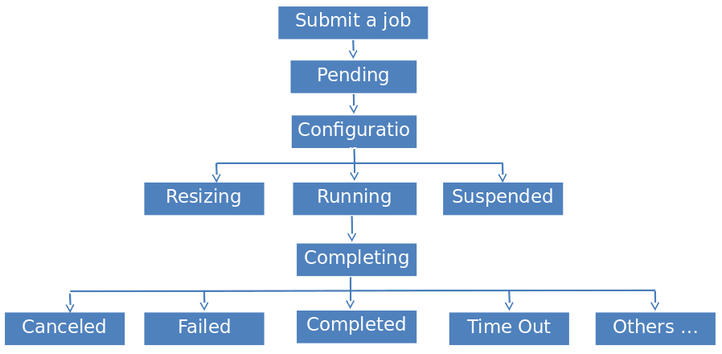
Life Cycle of a Job
Waiting for resource allocation
Source: https://portal.biohpc.swmed.edu/content/guides/slurm/
By user or admin
Successfully completion of a job
Job terminated upon reaching its time limit
Job failure, incomplete run
e.g. Compute node is down

Slide 5
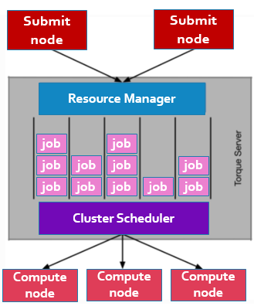
Scheduler Basics
The scheduler is the interface for the users on the login nodes to send work to the compute nodes
1- User submits job to HPC via scheduler
2- Scheduler adds the job to a job queue
3- Based on the resources the job needs, the scheduler will decide when the job will leave the queue
4- Scheduler will decide on which (part of the) back-end nodes job will run or decide to kill the job

Slide 6
Resource Management Steps
Based on job requirements: selection of nodes
1
First step: Selection
Based on job requirements: allocation of resources from selected nodes
2
Second step: Allocation
Distribution of each sub-job (tasks) to Selected Nodes
3
Third step: Distribution

Slide 7
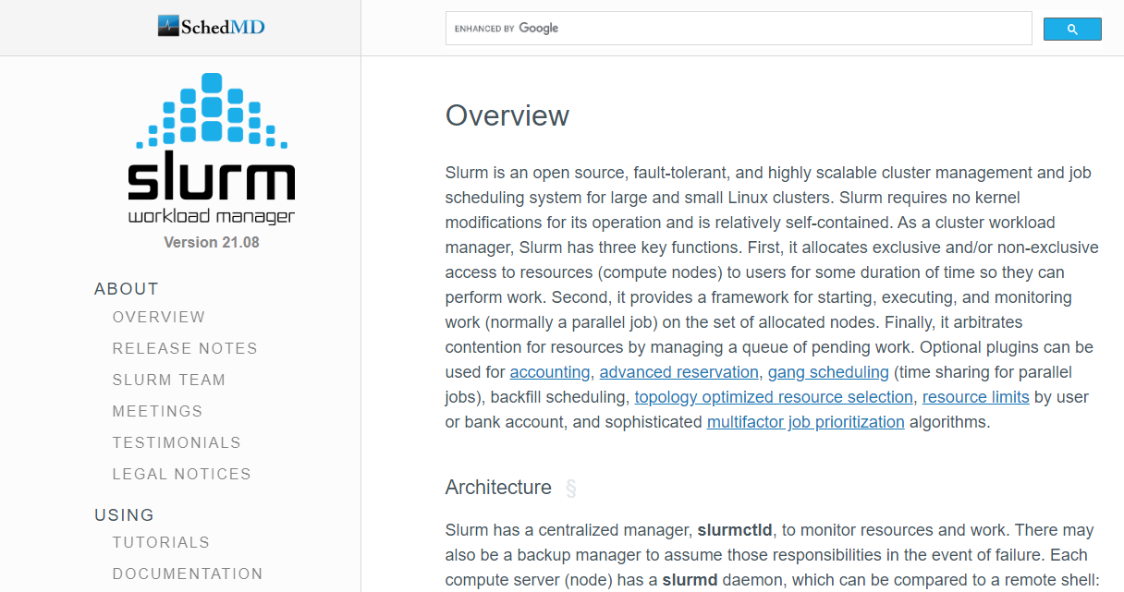
What is Slurm?
Simple Linux Utility for Resource Management
Site & Documentation:
  https://slurm.schedmd.com/ , https://slurm.schedmd.com/documentation.html

Slide 8
Slurm HPC Scheduler
(Short overview)
Highly scalable cluster management
For large and small Linux clusters
On about 60% of the TOP500 supercomputers [hpcc,2019]
Documentation states that:
  It supports up to 65’000 CNs
  120’000 jobs/hour sustained
  High Availability features
  Accounting on Relational DataBase
  Powerful scheduling functionalities
  It is possible to use MAUI/MOAB or LSF as scheduler on top of SLURM
BackupController=[backup name]
BackupAddr=[backup Address]
StateSaveLocation=[SharedDirectory]
AccountingStorageBackupHost=[backup name]

Slide 9
Slurm Properties
Development started in 2002 at Lawrence Livermore National Laboratory as a resource manager for Linux clusters
Sophisticated scheduling plugins added in 2008
About +500,000 lines of C code
Active global development community
Highly scalable, Open source, Secure
Fault-tolerant (no single point of failure)
Slurm is aware of network topology and use it in node selection.

Slide 10
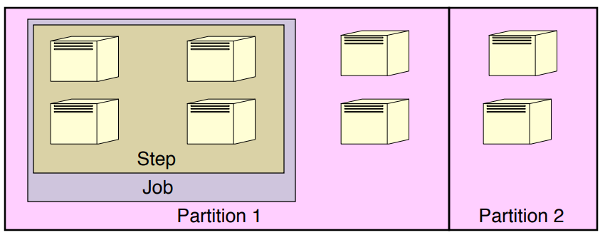
Slurm Entities
The entities managed by SLURM services:
  Compute nodes
  Compute resources
  Partitions (Queue)
  Job steps (sets of tasks within a job)
Source: https://www.cs.wcupa.edu/lngo/csc466/14-schedulers/index.html

Slide 11
Slurm- Services
Slurmctld - central controller (typically one per cluster)
  Monitors state of resources
  Manages job queues
  Allocates resources

Slide 12
Slurm- Services
Slurmd - Compute node daemon
  Running on each compute node
  Monitors all tasks running on the compute node, accepts work (tasks), launches tasks
  Kills running tasks upon requests

Slide 13
Slurm Configuration
ASCII file which describes general Slurm configuration information
Includes information about:
  Defenition of compute nodes
  How compute nodes are grouped into partitions
  Scheduling policies / algorithms
  This file should be consistent across all nodes in the cluster
Slurm.conf
SlurmctldHost=server
SlurmctldAddr=192.168.227.143
AuthType=auth/munge
AuthInfo=/var/run/munge/munge.socket.2
NodeName=server NodeAddr=192.168.227.143 CPUs=2 RealMemory=1945 Sockets=2 CoresPerSocket=1 ThreadsPerCore=1 State=UNKNOWN
PartitionName=debug Nodes=ALL Default=YES MaxTime=INFINITE State=UP
PartitionName=cache Nodes=linux1 Default=YES MaxTime=INFINITE State=UP
…
Node definition:
Example:
Characteristics (sockets, cores, threads, memory, features)
Network addresses
NodeName=server NodeAddr=192.168.227.143 CPUs=2 RealMemory=1945 Sockets=2 CoresPerSocket=1

Slide 14
Slurm Configuration
ASCII file which describes general Slurm configuration information
Includes information about:
  Defenition of compute nodes
  How compute nodes are grouped into partitions
  Scheduling policies
  This file should be consistent across all nodes in the cluster
Slurm.conf
SlurmctldHost=server
SlurmctldAddr=192.168.227.143
AuthType=auth/munge
AuthInfo=/var/run/munge/munge.socket.2
NodeName=server NodeAddr=192.168.227.143 CPUs=2 RealMemory=1945 Sockets=2 CoresPerSocket=1 ThreadsPerCore=1 State=UNKNOWN
PartitionName=debug Nodes=ALL Default=YES MaxTime=INFINITE State=UP
PartitionName=cache Nodes=linux1 Default=YES MaxTime=INFINITE State=UP
…
Partition definition:
Example:
Characteristics of queues and usage limits (Time, allowed users, MaxTime, preemption mode
Provides subsets of the cluster
Group machines with same features
PartitionName=debug Nodes=ALL Default=YES MaxTime=INFINITE State=UP

Slide 15
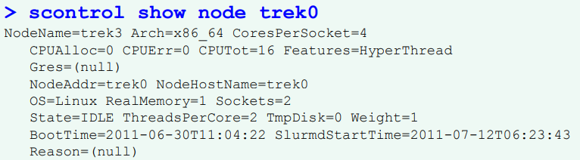
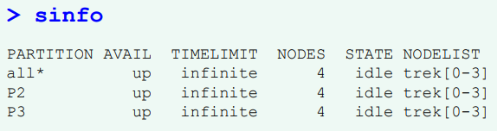
Usefull Commands Overview
Job Submission, allocation and release the allocation:
  salloc, sbatch, srun
Node/partition state:
  sinfo, scontrol
Job signaling:
  scancel
Show information about slurmctld execution
  sdiag

Slide 16
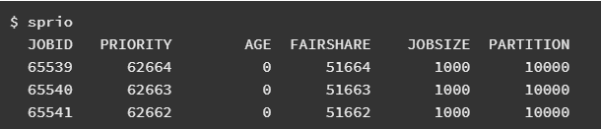

Useful Commands Overview
Information for all pending jobs:
  sprio
Statisticall information about tasks of a job
  sstat

Slide 17
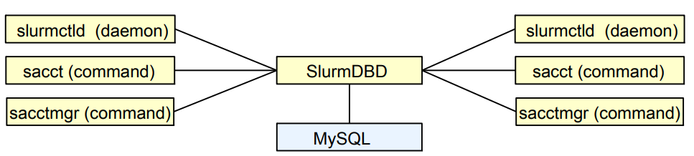
Accounting
Slurm can be configured to collect accounting information for every job and job step executed
Accounting records can be written to a simple text file or a database
The accounting daemon, slurmdbd must be running and using the MySQL/MariaDB database
We can report resource usage for running or terminated jobs which can be useful to detect load imbalance between the tasks

Slide 18
Slurm : pros & cons
The scheduling functionalities is powerful but can be enriched Security is managed using “munge” as with the latest version of Torque
Various parameters to choose from (customizable). e.g, burst buffer support
Used and referenced by both academia & industry
More frequent updates (at least one commit every week)
Open source. Better for development
There is no RPM available for installing it
Poor documentation. e.g, installation guide is not comprehensive, lacking good usage examples.
Paid support

Slide 19
Torque vs Slurm
Slurm | Torque | Properties
2003 | 2003 | Initial release
1420 | 258 | Introduced paper citation
yes | Is not after 2018 | Open-source
Is not good for starters | Rich | Documentation
Need certain level of expertise from administrator | Relatively easy | Installation
So far many updates | Rarely updates, stable release in 2021 | Updates
Paid support | Poor support | Support
Yes | Yes | Interactive jobs

